Slide 1
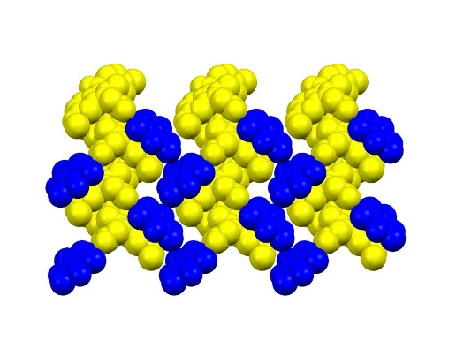
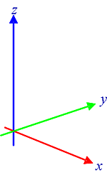
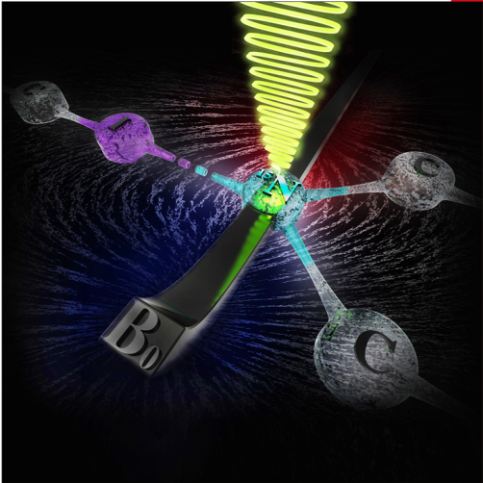
Università degli Studi di Torino
Doctoral School of Sciences and Innovative Technologies
PhD Program in Chemical and Material Sciences XXIX Cycle
PhD Thesis Defence
Monday 30th January 2017, 12:00 p.m.
Sala di rappresentanza, Via P. Giuria 9, Torino
PhD candidate
Paolo Cerreia Vioglio
“Crystal Engineering with Hydrogen and Halogen Bonds: a Solid-State Nuclear Magnetic Resonance, X-ray Crystallography, and Computational Study”
Supervisor
Prof. Roberto Gobetto
OPPONENTS
Prof. Dario Braga (University of Bologna)
Prof. Michele Chierotti (University of Turin)
Prof. Giuseppe Resnati (Politecnico di Milano)

